Slide 1







`
DOWNTIME
SHIELD
MANUFACTRING DOWNTIME ANALYSIS

Slide 2










OUR PROJECT TEAM
Ziad Abdullah
John Mamdouh
Kenzy Massoud
.
.
Carol Nader
Olivia Ashraf
Mera Amr
Supervised by DR Amal Mahmoud

Slide 3


AGENDA
AGENDA
1-Introduction
5-Insights
2-WORKFLOW
6- Recommended Solutions
3-Objective
4-Methodology

Slide 4
AGENDA
AGENDA
1-Introduction
5-Insights
2-WORKFLOW
6- Recommended Solutions
3-Objective
4-Methodology

Slide 5


1-INTRODUCTION
Downtime impacts productivity and increases costs.
This project analyzes real factory data to track and classify downtime events.
Uses data analysis to identify root causes and inefficiencies.
Aims to support better maintenance and operational decisions.
Focused on boosting efficiency and reducing unplanned stops.
Project Overview
Tools Used
Problem Context

Slide 6
AGENDA
AGENDA
1-Introduction
5-Insights
2-WORKFLOW
6- Recommended Solutions
3-Objective
4-Methodology

Slide 7















Data Collection
2-WORKFLOW
Data Preparation
Data Validation & Analysis
Dashboard & Insights
Recommendations

Slide 8
AGENDA
AGENDA
1-Introduction
5-Insights
2-WORKFLOW
6- Recommended Solutions
3-Objective
4-Methodology

Slide 9

3-OBJECTIVE
Track and classify downtime events accurately.
Identify root causes and impact on productivity.
Analyze trends and patterns in downtime data.
Provide insights to reduce unplanned stoppages.
Support predictive maintenance and efficiency
improvements.
Project Overview
Tools Used
Problem Context

Slide 10
AGENDA
AGENDA
1-Introduction
5-Insights
2-WORKFLOW
6- Recommended Solutions
3-Objective
4-Methodology

Slide 11

4-Methodology
Dataset
about dataset
dataset description
Data preprocessing
Data preparation
Data cleaning & preprocessing
Data modeling
Data Visualization
Key Insights from Downtime Patterns
Project Overview
Tools Used
Problem Context

Slide 12

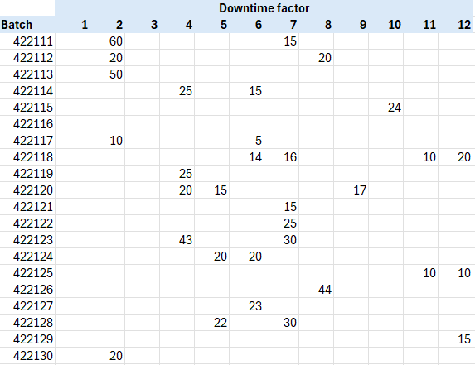
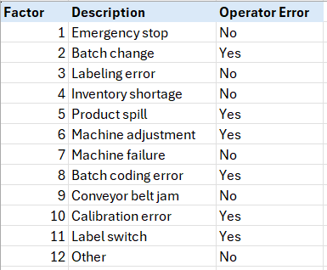
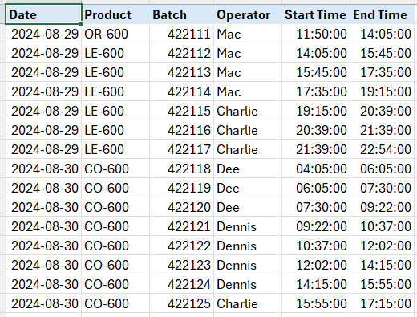
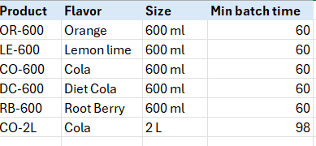

Dataset
about dataset
Downtime sheet: Logs errors per batch 40 rows × 12 columns
Factors sheet: Describes and categorizes error types
Manufacturing Data sheet: Includes operator, batch date, start/end time 40 rows × 6 columns
Product sheet: Lists product information linked to each batch
dataset description
Downtime – Contains information on various types of errors (factors) that caused downtime, recorded per batch.
Factors (Errors) – Lists and categorizes the different types of errors that can occur in the production process.
Manufacturing Data – Includes detailed batch-level data such as:
Operator responsible for the batch
Date of the batch
Start and end times for each batch
Product – Provides information related to the products being manufactured.

Slide 13
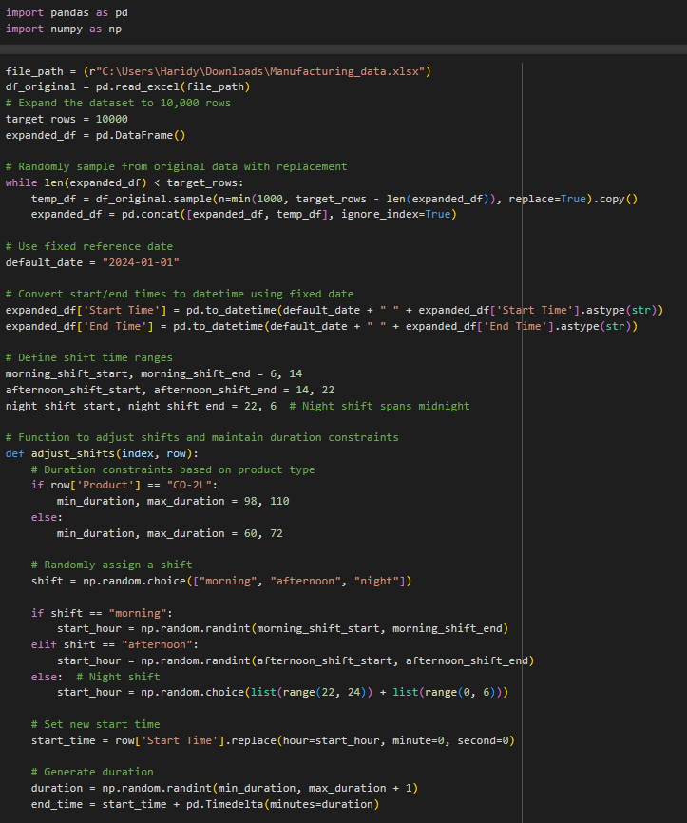
Data preprocessing
Data preparation
The original dataset had only 40 rows, which limited analysis. To extract deeper insights, we expanded it to 10,000 rows by following the same patterns. This synthetic data simulates a larger manufacturing setup for better analysis of shifts, downtime, and operator performance
Main Goals of the Code:
Expand the data to 10,000 rows using random sampling with replacement.
Convert Start and End Time columns to datetime using a fixed reference date.
Define 3 shifts: Morning, Afternoon , Night
. Randomly assign shifts and adjust batch start times accordingly.
Set realistic batch durations based on product type:
Make sure End Time stays within shift limits
. Calculate batch duration in minutes.

Slide 14
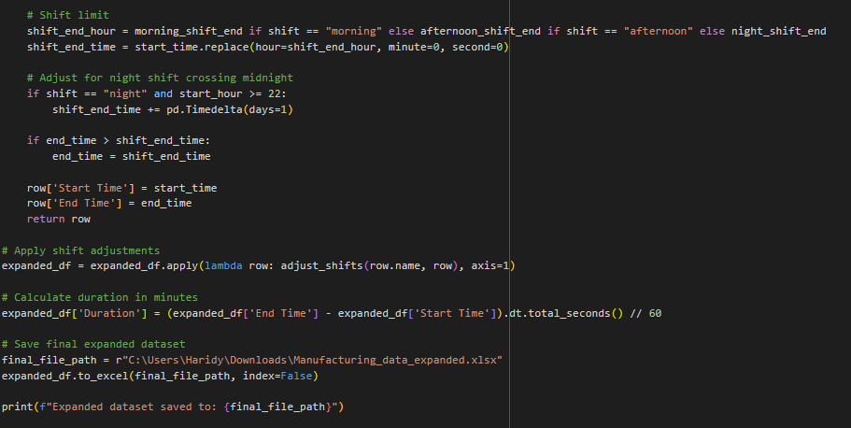
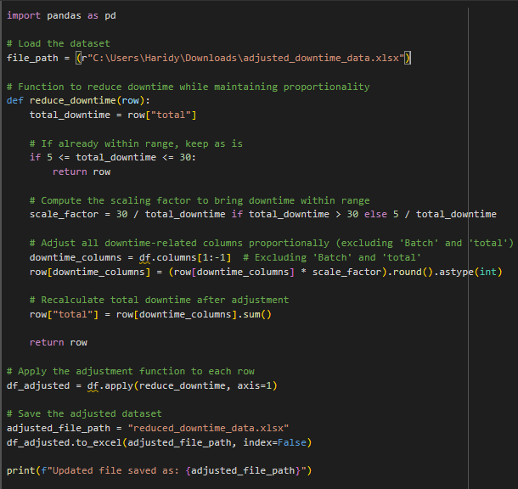
Data preprocessing
Data preparation
Scale downtime values proportionally for each batch using a defined function.
Ensure realistic total downtime per batch (between 5–30 minutes).
Adjust all downtime columns proportionally while preserving their relative weights.
Recalculate total downtime for each batch after adjustment.
Save the cleaned and adjusted dataset to a new Excel file for further analysis.

Slide 15
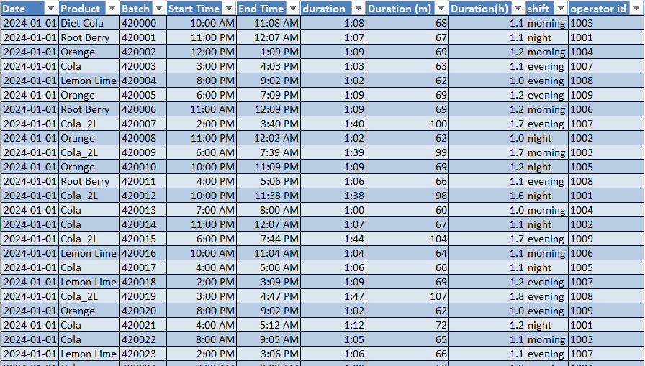
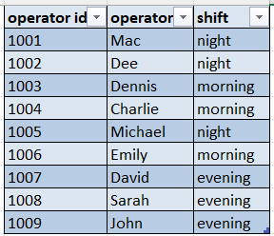
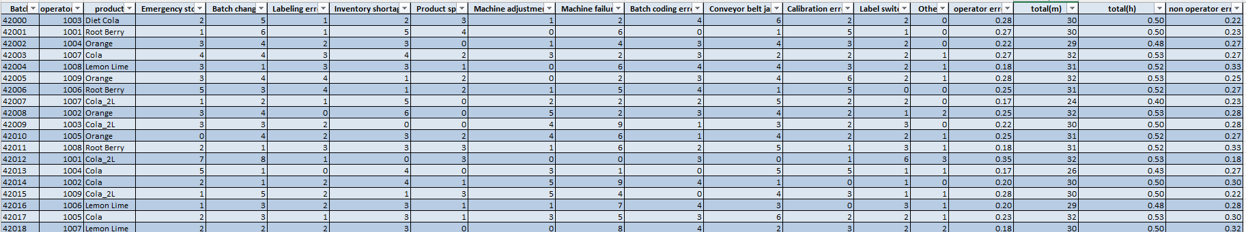
Data preprocessing
Data cleaning & preprocessing
Preprocessing and cleaning: The data was cleaned and preprocessed.
No outliers: There were no outliers in the dataset since we made adjustments.
Expanded dataset: The number of operators was increased from 4 to 9.
Shifts adjustment: Each shift now includes 3 operators.
Duration constraint: The duration was constrained to a range of 60 to 110 minutes, aligning with the global standard for soft drink factories.
More realistic data: After these adjustments, the data is now more realistic and closer to reality.

Slide 16
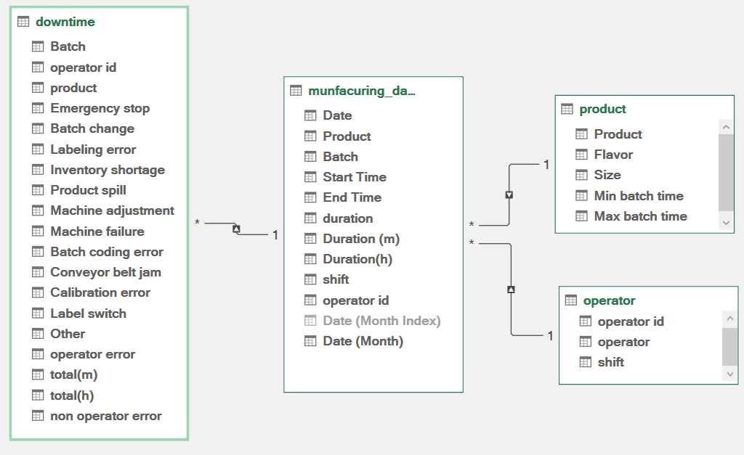
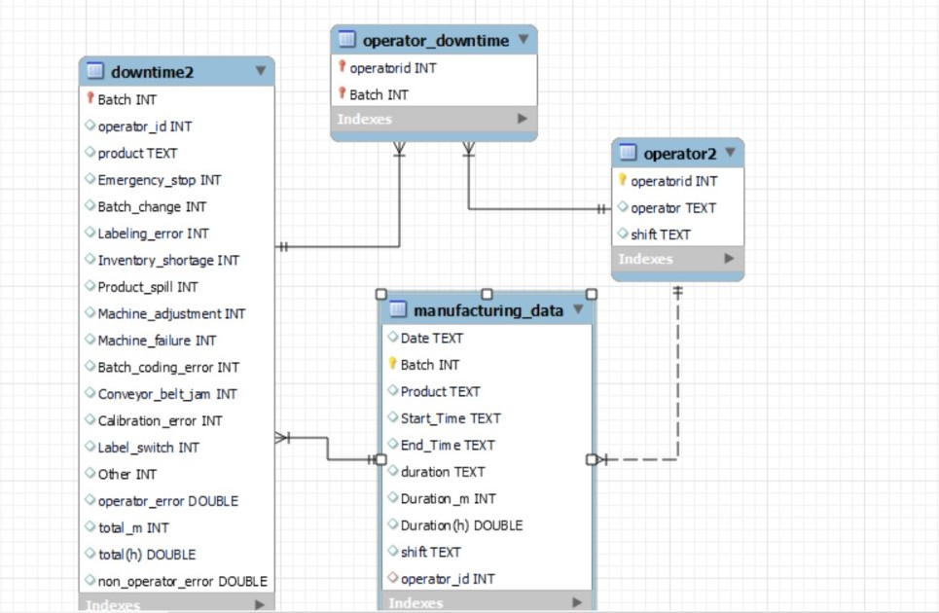
Data preprocessing
Data Modeling
Modular Design – Separates downtime tracking, batch manufacturing data, and operator details for clarity
Comprehensive Downtime Tracking 12+ categories (e.g., machine failures, labeling errors) with operator vs. non-operator error differentiation.
Batch Process Monitoring Records batch start/end times, durations (in minutes/hours), and links to operators and shifts.
Operator Performance Analysis – Tracks operator-shift assignments and ties them to downtime events.
Structured Relationships Uses Batch and Operator_Id to connect downtime, manufacturing, and operator tables.
Analysis-Ready Metrics Includes pre-calculated durations (minutes/hours) and supports time-based reporting.

Slide 17
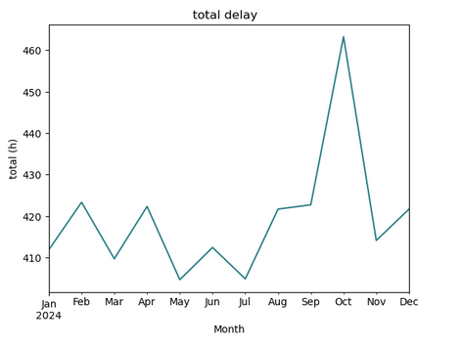
Data Visualization
Key Insights from Downtime Patterns
Which months had the most/least downtime?

Slide 18
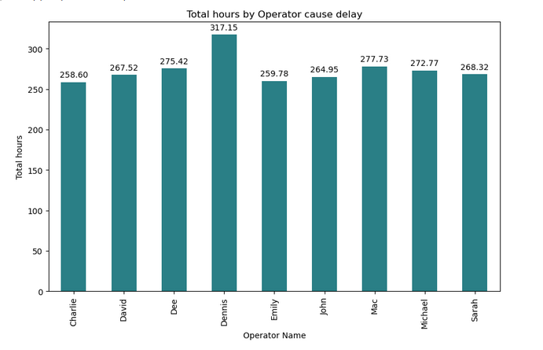
Data Visualization
Key Insights from Downtime Patterns
Which operator caused the most delays?
Who needs the most urgent training based on delay hours?

Slide 19
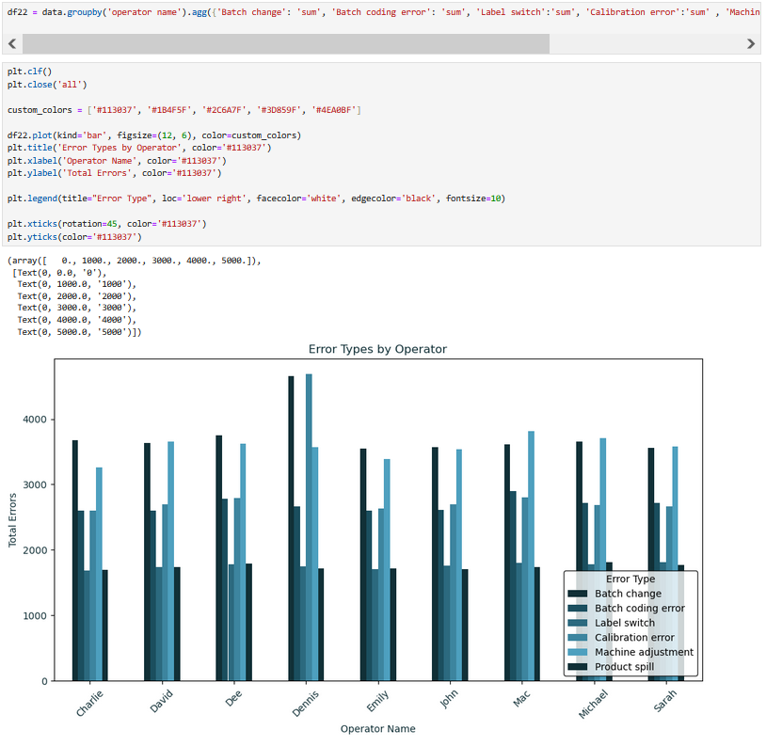
Data Visualization
Key Insights from Downtime Patterns
Which operator has the highest total errors, and which error type is their biggest problem?
Which operator needs targeted training for a specific error ( 'Calibration error')?

Slide 20
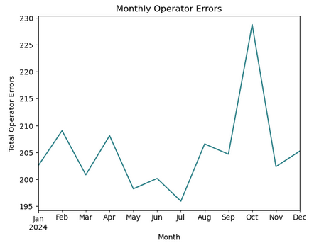
Data Visualization
Key Insights from Downtime Patterns
Which month had the highest operator errors?
Are operator errors improving over time?

Slide 21
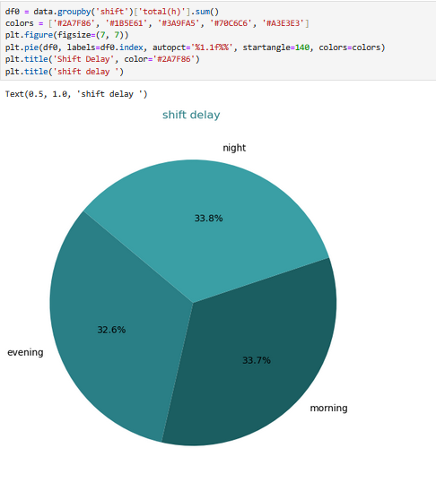
Data Visualization
Key Insights from Downtime Patterns
Which shift has the highest downtime hours?
How much longer are night shift delays compared to morning shift?

Slide 22
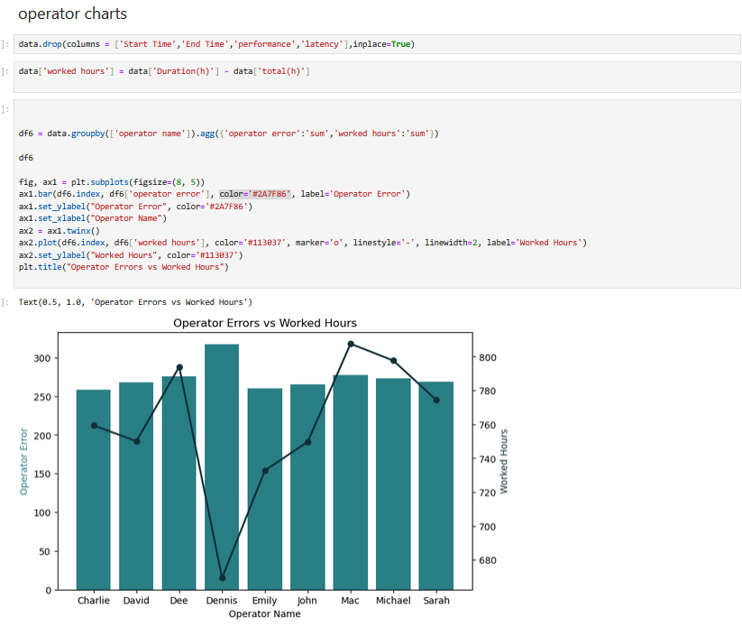
Data Visualization
Key Insights from Downtime Patterns
Does working more hours lead to more errors?
Which operator stands out for either good or bad performance?

Slide 23
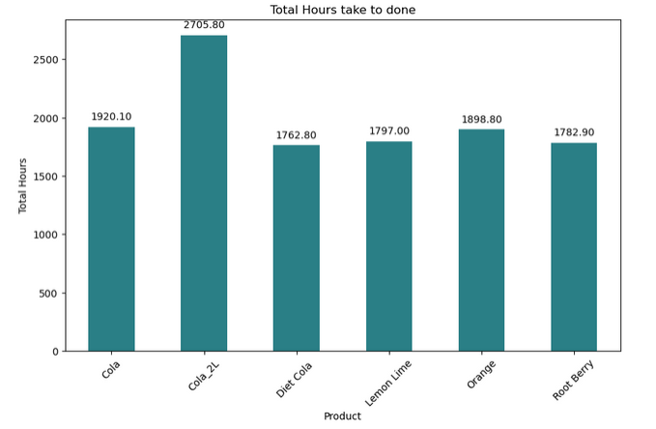
Data Visualization
Key Insights from Downtime Patterns
Which product takes the longest to produce ?

Slide 24
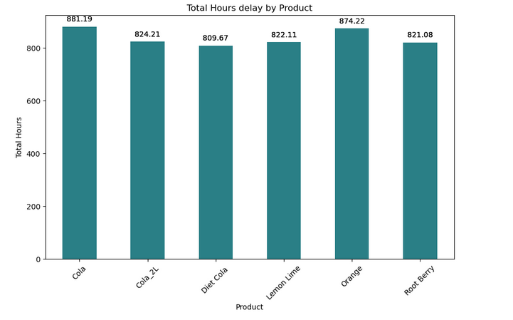
Data Visualization
Key Insights from Downtime Patterns
Which product causes the most production delays?

Slide 25
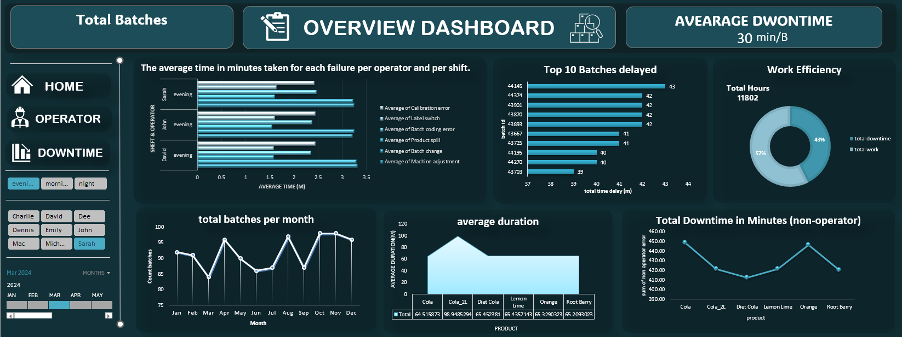
Data Visualization
10,000

Slide 26
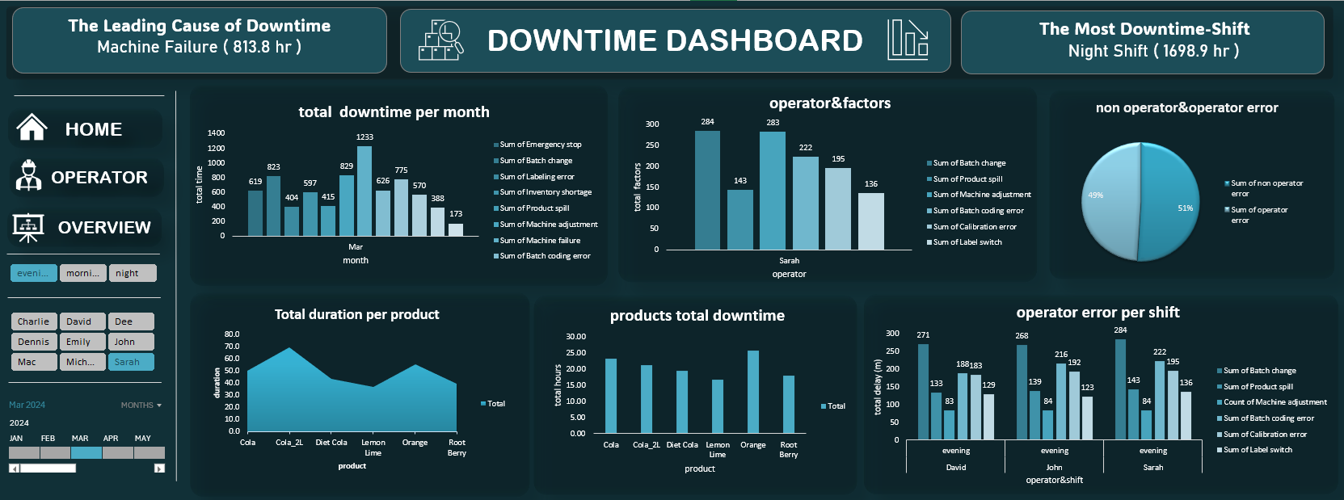
Data Visualization

Slide 27
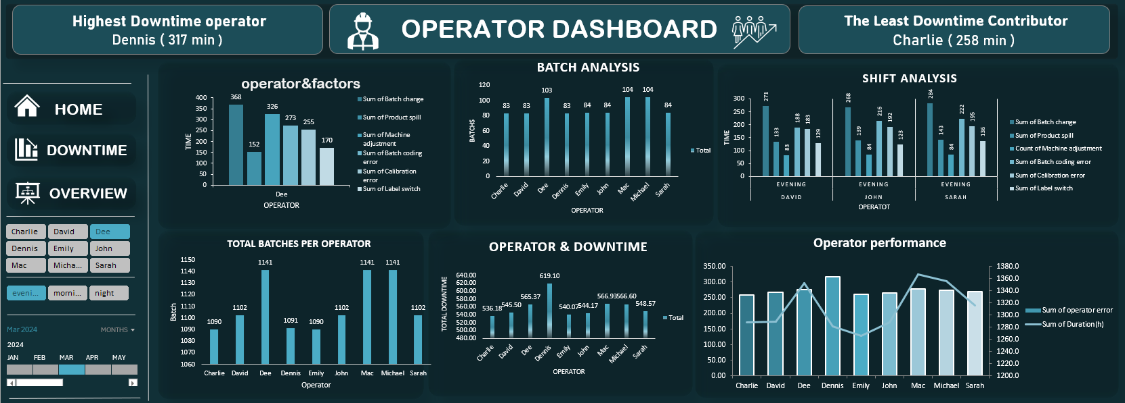
Data Visualization

Slide 28
AGENDA
AGENDA
1-Introduction
5-Insights
2-WORKFLOW
6- Recommended Solutions
3-Objective
4-Methodology

Slide 29

5-Insights
Operator Performance Issue
Dennis is the worst-performing operator with:
Exceptionally high error rates
Low working hours
Significant outlier compared to shift peers
Error Pattern Analysis
Most frequent operator-related failure: Machine Failure
Least common issue: Other miscellaneous errors
Shift-specific patterns: Night/Evening Shifts: Machine Adjustment errors dominate Morning Shift: Calibration Errors are most prevalent
Production Bottlenecks
Cola product requires the longest production time
Appears to be the most time-intensive product in the lineup
Shift Performance Trends
Consistent error rates among all operators except Dennis
Night shift shows particular vulnerability to equipment issues
Project Overview
Tools Used
Problem Context

Slide 30
AGENDA
AGENDA
1-Introduction
5-Insights
2-WORKFLOW
6- Recommended Solutions
3-Objective
4-Methodology

Slide 31

6- Recommended Solutions
1. For Dennis' Performance Issues
Immediate Actions:
Conduct one-on-one performance review with Dennis to identify root causes
Implement a 30-day probation period with clear KPIs
Pair with a high-performing operator for mentoring
Training Solutions:
Mandatory machine operation certification
Error simulation training for most frequent mistakes
Weekly performance monitoring with HR
2. Machine Failure Reduction
Preventive Measures:
Daily machine inspection checklist for all shifts
Predictive maintenance program for critical equipment
Spare parts inventory optimization
Operator-Specific:
Machine operation refresher courses quarterly
Visual troubleshooting guides at each station
Error reporting incentive program
Project Overview
Problem Context

Slide 32
6- Recommended Solutions
3. Shift-Specific Solutions
Night/Evening Shifts:
Dedicated adjustment technician during peak hours
Pre-shift machine calibration verification
Enhanced lighting for precision work areas
Morning Shift:
Weekly calibration equipment certification
Digital calibration tracking system
Vendor-managed calibration services
4. Cola Production Optimization
Process Improvements:
Time-motion study for Cola production line
Bottleneck analysis with Pareto charts
Parallel processing implementation
Equipment Upgrades:
High-speed filling heads for Cola line
Automated quality control checkpoints
Predictive maintenance for Cola-specific machines
5. Systemic Improvements
Cross-shift knowledge sharing sessions
Digital performance dashboards for real-time monitoring
Root cause analysis team for recurring issues
Reward system for error-free shifts
Project Overview
Problem Context

Slide 33
AGENDA
Thank You

